Slide 1



Course overview
“JUnit Magic”
2017

Slide 2
Speaker’s Profile
Viktor Savonin
  10 years of software development experience
    Java developer
    Lead Java developer
    Java Team Leader
  Master degree in Computer Science from TSI
  Currently
    Senior Java developer in MeaWallet

Slide 3
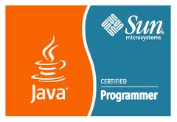

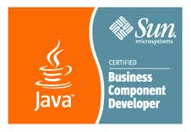

Speaker’s Profile
Sun Certified: SCJP, SCWCD, SCBCD

Slide 4
Contact information
mail: viktor.savonin@gmail.com
mail: javagurulv@gmail.com

Slide 5
Course format
Course length: 1 day (8 hours)
Course approach:
  presentations
  discussions
  practice
Level: Beginner / Intermediate

Slide 6

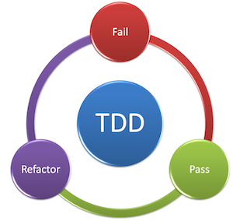

What course about

Slide 7

Do you know
JUnit
Mock objects
Mockito
TDD
Do you write tests

Slide 8
Course Objectives (1)
Overview of testing:
  Black box strategy
  White box strategy
  Class level testing
  Integration testing
  System or acceptance testing

Slide 9

Course Objectives (2)
Understand core Java testing framework

Slide 10

Course Objectives (3)
Understand Mock objects
Drink Mockito ☺
Test Driven Development

Slide 11
Target Audience
Java developers
UI developers
DB developers
All best developers, who want to get knowledge and practical experience with Java based testing frameworks

Slide 12
Course Syllabus
Section 1: Testing introduction

Slide 13
Course Syllabus
Section 1: Testing introduction
Section 2: Testing levels and strategies

Slide 14
Course Syllabus
Section 1: Testing introduction
Section 2: Testing levels and strategies
Section 3: JUnit introduction

Slide 15
Course Syllabus
Section 1: Testing introduction
Section 2: Testing levels and strategies
Section 3: JUnit introduction
Section 4: JUnit advanced concepts

Slide 16
Course Syllabus
Section 1: Testing introduction
Section 2: Testing levels and strategies
Section 3: JUnit introduction
Section 4: JUnit advanced concepts
Section 5: Mock Objects – Drink Mockito

Slide 17
Course Syllabus
Section 1: Testing introduction
Section 2: Testing levels and strategies
Section 3: JUnit introduction
Section 4: JUnit advanced concepts
Section 5: Mock Objects – Drink Mockito
Section 6: Test Driven Development

Slide 18
Course Syllabus
Section 1: Testing introduction
Section 2: Testing levels and strategies
Section 3: JUnit introduction
Section 4: JUnit advanced concepts
Section 5: Mock Objects – Drink Mockito
Section 6: Test Driven Development
Section 7: Behavior Driven Development

Slide 19
Course Syllabus
Section 1: Testing introduction
Section 2: Testing levels and strategies
Section 3: JUnit introduction
Section 4: JUnit advanced concepts
Section 5: Mock Objects – Drink Mockito
Section 6: Test Driven Development
Section 7: Behavior Driven Development
Practice Practice Practice

Slide 20

Any Questions?

